Slide 1




Meet EELISA
January / 2026

Slide 2
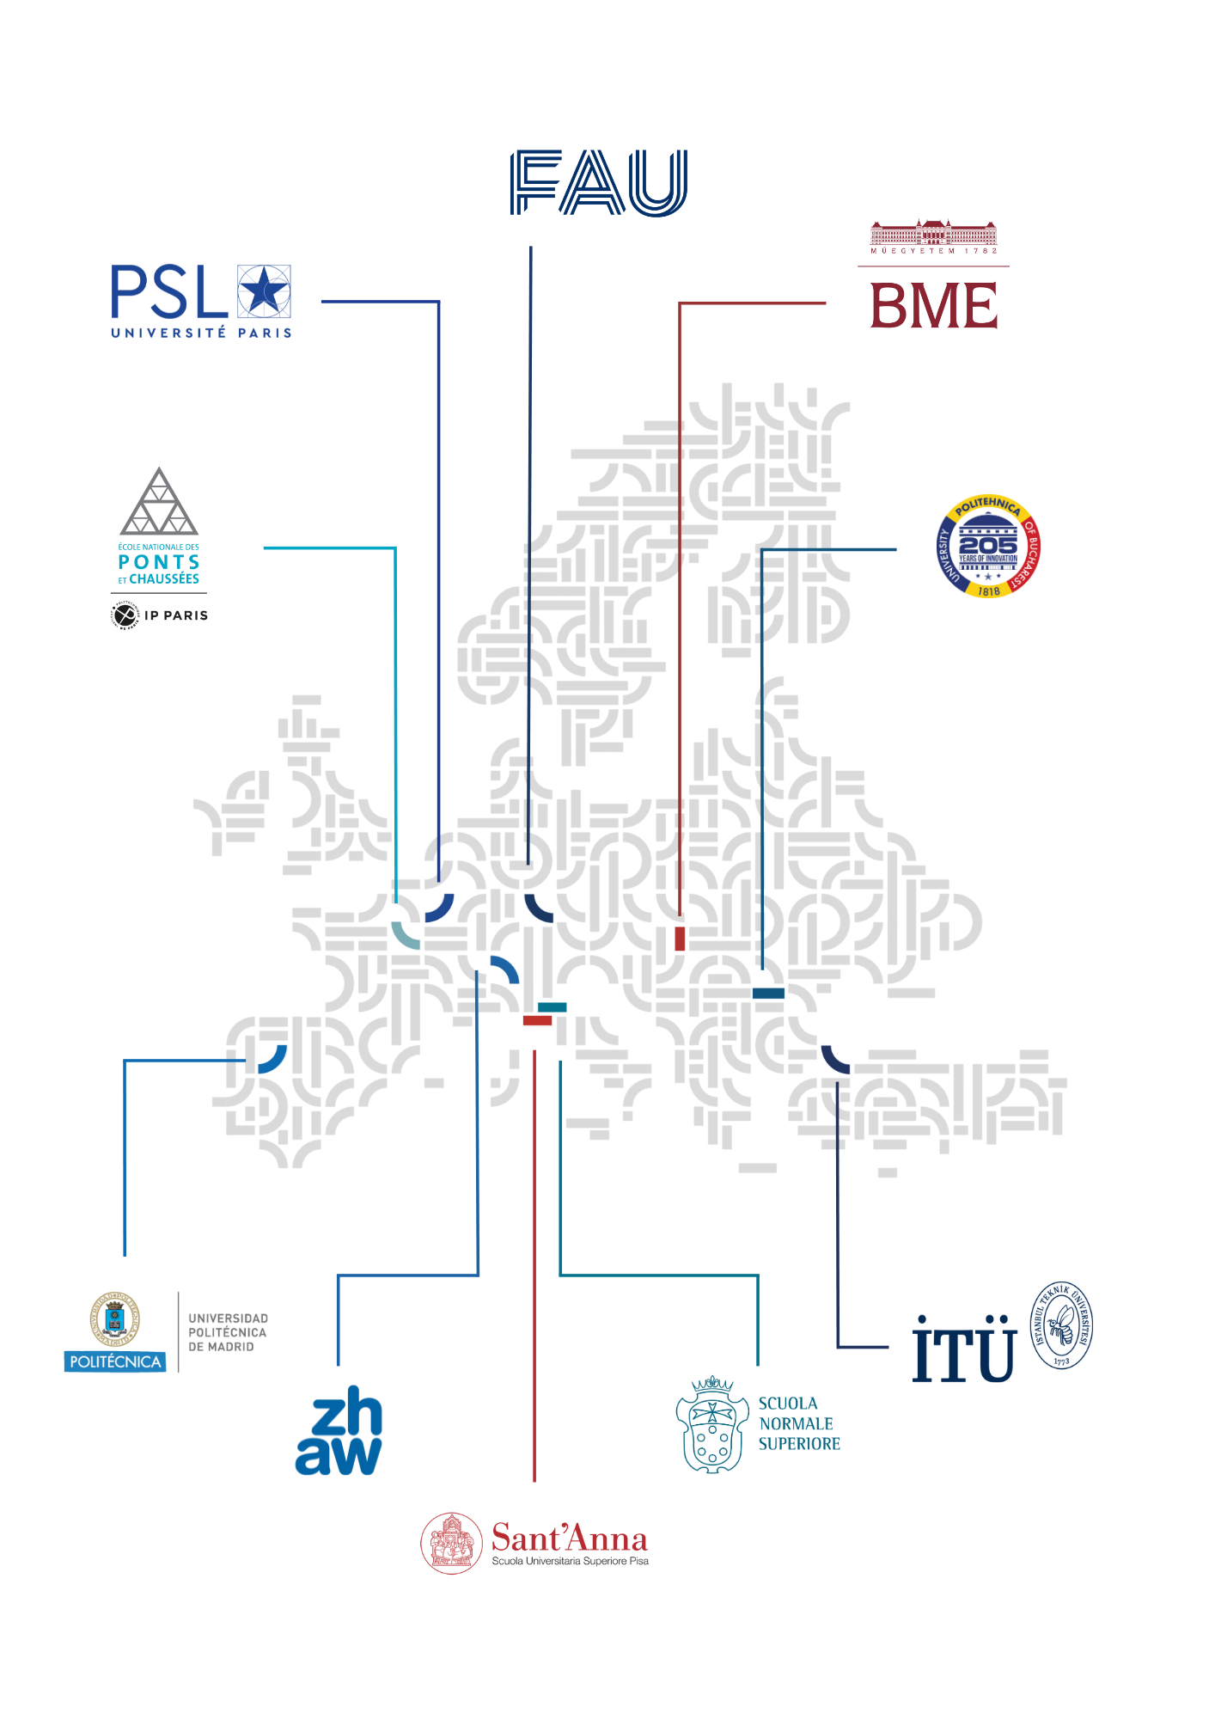


EELISA
Members

Slide 3
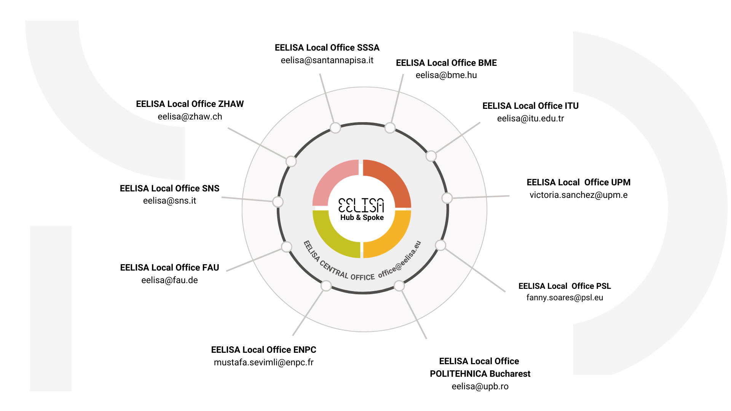
EELISA Hub & Spoke structure
Student Council
Academic
Coordinators

Slide 4
Our vision into practice
Bridging Engineering, Sciences and Humanities for Equitable, Sustainable and Digital Societies
1. CREATING TRANSFORMATIVE EXPERIENCES
THROUGH EELISA CAMPUS
2. CONNECTING COMMUNITIES
THROUGH UNPRECEDENTED COLLABORATION
To foster multi-layered, innovative and flexible learning opportunities that are easily accessible across the 10 partners of EELISA (seamless in-person, hybrid and digital mobility).
To foster multi-layered, innovative and flexible learning opportunities that are easily accessible across the 10 partners of EELISA (seamless in-person, hybrid and digital mobility).
To consolidate the shared ecosystem of EELISA Communities as the learning lab of systemic, structural, and sustainable cooperation models.
3. BUILDING THE UNIVERSITY OF THE FUTURE
WITH A HOLISTIC APPROACH
To consolidate the EELISA European University as a sustainable Alliance that progressively grows in its depth, scope, diversity and ambition.
Meet EELISA / JUN 2024

Slide 5
Our vision - building blocks
1. CREATING TRANSFORMATIVE EXPERIENCES THROUGH EELISA CAMPUS:
2. CONNECTING COMMUNITIES THROUGH UNPRECEDENTED COLLABORATION
3. BUILDING THE UNIVERSITY OF THE FUTURE WITH A HOLISTIC APPROACH
EELISA EUROPEAN ENGINEER
Innovative recognition models
Mobility
Innovative Teaching Hubs
Internships & Apprenticeships
Digital Campus
Alliance Integration
Partnerships
Organic Growth
Gender Equality and Inclusiveness Policies
EELISA COMMUNITIES
Developing and promoting a strong network of talent
Boosting joint research strategies, and innovation and entrepreneurship ecosystems
Shared research facilities and structures
Meet EELISA / JUN 2024

Slide 6

PSL’s COMMITMENT TO EELISA
EELISA Dean of Studies from PSL
Master Health Science and Engineering
Partners: PSL (France), SSSA (Italy), UPM (Spain), ZHAW (Switzerland), ITU (Turkey)
Co-leader of the working group on EELISA European Campus
Development of Mobility
Development of a Gender Equality Plan and an Inclusion Plan
Development of a Sustainable Development Plan
Co-leader of the WP5 on education (central group at EELISA)
Development of EELISA Joint Degree (Master Health Science and Engineering is part of it)
Development of new education offers
Driver for the integration of the USP into EELISA

Slide 7






PSL’s COMMITMENT TO EELISA
Call for projects EUROPEANIZATION OF TRAINING 2025 – ANR Funding
Objectives of the Call
· Develop an innovative training offer in partnership with EELISA members
· Encourage incoming and outgoing mobility with EELISA partners
· Strengthen attractiveness and develop the content of training for an international audience
Total budget:
100 k€
8 proposals selected | Ateliers, écoles d’été, projets de recherche interdisciplinaires (min. 3 partenaires).
Institutions | Chartes, Mines, Chimie, Malaquais
Topics | Philology, Languages, Architecture, Chemistry, Sustainable Development, Energy
Project Typology | Thematic school, virtual class, workshop, online course, internships, language exchanges
Notes:
The ANR (French National Research Agency) is a French government funding agency that supports and promotes scientific and technological research through competitive project grants.

Slide 8

EELISA OPPORTUNITIES 2 AND FUTURE ACTIONS
1st PhD Symposium EELISA – Budapest, 28-29 novembre 2025
10 to 15 PhD students per institution
Topics: EU funding opportunities (ERC, MSCA, etc…), Career building, mobility opportunities, publication strategies…
2nd PhD Symposium EELISA in Paris, fall 2026
4th Student competition – Madrid, 21-22 May 2026
Summer schools are advertised on the EELISA digital campus
Internship proposals are published on the EELISA digital campus
Development of Blended Intensive Programs (BIPs)
Development of joint degrees

Slide 9
EELISA Joint Academic Call
Programme | Description | Max. Funding | Actions Funded
Pairing | Collaborative teaching between institutions without modifying core learning outcomes. | €5,000 | 10-12
Joint Course | Collaboratively designed/delivered course with shared outcomes and coordinated teaching. | €8,000 | 10-12
Micro-credentials | Short, certified learning experiences aligned with EU principles. | €10,000 | 4-6
Aligning Degrees | Align existing engineering programmes with EELISA European Engineer Profile. | €3,000 | 5
Joint Degrees | Jointly designed/delivered programme leading to a shared degree. | €15,000 (€5K + €10K) | 2-3
Launch : April 23
Deadline: June 20
Objectives:
Increase EELISA Academic Offer
Increase EELISA Mobility opportunities
Meet EELISA / JUN 2024

Slide 10


Thanks!
Follow @eelisa_eu on social media
Check the web: eelisa.eu
Subscribe to EELISA Newsletter

Slide 12
EELISA RECOGNITION
EELISA Supplement
Acquis si l'étudiant en mobilité obtient 10% des ECTS nécessaires pour avoir son diplôme
EELISA Credential
Reconnaissance acquise si la formation est en lien avec des ODD. C’est en lien avec les communautés
EELISA Degree
Acquis avec une mobilité entre les partenaires EELISA sur la base de critères communs aux partenaires

